Slide 1
COVID-19 Handbook Lino Zamora

Slide 2
Covid-19 RELATED PHRASES & Definitions
February 11, 2020
World Health Organization announced official name for virus causing the 2019 novel outbreak.
Many types of human coronaviruses
Cause mild upper respiratory tract illnesses
COVID-19 is new that has not been seen in humans
Personal Protective Equipment or PPE
Protective clothing, helmets, gloves, face shields, goggles, surgical masks, respirators and other equipment
Helps prevent exposure to infection or illness

Slide 3
Hours/Days of Operations
Centers will be open for children for the hours and times noted in center calendar
Staggered hours
You will have a preferred arrival time specific to child
Options
Face to face instruction
Remote learning assisted by parent
As needed
Closing center for short period or longer indefinite period due to Covid-19 outbreak
If outbreak, center will move to remote learning to children in program
Proactive Parents
Make arrangement with alternative caregiver in the event center closes

Slide 4
Parent Drop-off and Pick-up
Families
Assigned a time for drop off and Pick up
Ensure social distancing and easier to navigate parking lots at centers
Teachers
Responsible for signing children in and out of center
Individuals
Need to be on pick-up list
Need a photo ID at pick up time
Children Safety
Center will not release child to anyone not on list
Mandatory to wear a mask for drop off and pick up
Call before for pick up time and arrival
Late arrival need to call center and wait for health check

Slide 5
Covid-19 Screening
Center designee
Will do quick morning health check during drop off
Staggering times
Promote social distancing
Minimize spread
Health check updates
Taking child’s temperature
Fever above 99.5 or above or other signs of illness will not be allowed to attend or remain at center
Parents
Need to be alert for signs of illness in children
Keep them home when sick

Slide 6
Staff with PPE for Covid-19 screening
Staff are training to take precautions
PPE will be used during drop off
Teamwork
Parents & staff must work together
Keeps process safe, fast and efficient
Children with signs and symptoms will not be able to stay
Parent
Center can take your temperature if time permits
Parent with fever must return home with child

Slide 7
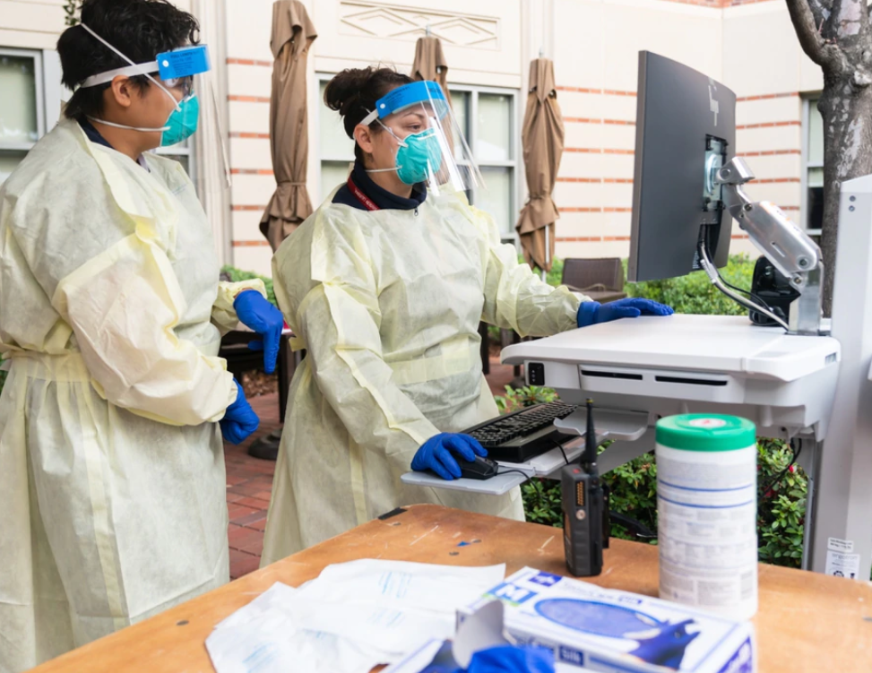
What to expect at the covid-19 screening?
Health check station
Staff will wear PPE
Social distancing will be implemented
NON-contact thermometer
Covid-19 questionnaire for parents
Children’s Hand Sanitizer

Slide 8
When does you child need to stay home
Fever
Above 99.5 or above
Shortness of breath/difficulty breathing
Cough, sore throat, chills, muscle ache, loss of taste or smell
Vomiting or diarrhea
Contagious Illness
Flu, pink eye, ringworm, scabies, chicken pox, measles, shigella, strep throat, Impetigo, or other
Head lice
Nebulizer treatments
Unable to go outside and/or participate in class due to cold or another ailment

Slide 9
Parents, volunteers and visitors
Parents/guardians, volunteers, visitors
Not allowed in class/center
Implementation will be until a safe solution is found for COVID-19
Appointments
To speak with director, staff or visit center
Parent must abide to health check

Slide 10
Child becomes ill at Center
Center Staff will check children temperature throughout the day
Sign/symptoms
Child will be taken to secure room/area to await pick up
Child must be picked up within 30 minutes
Staff with PPE will wait with child until pick up
Emergency Contact
Must be kept up to date
If No contact with parent, center will call individuals on contact list
Alternate contact must have info update and must be aware of being on list.
Obtain Health care professional clearance for return without restrictions

Slide 11
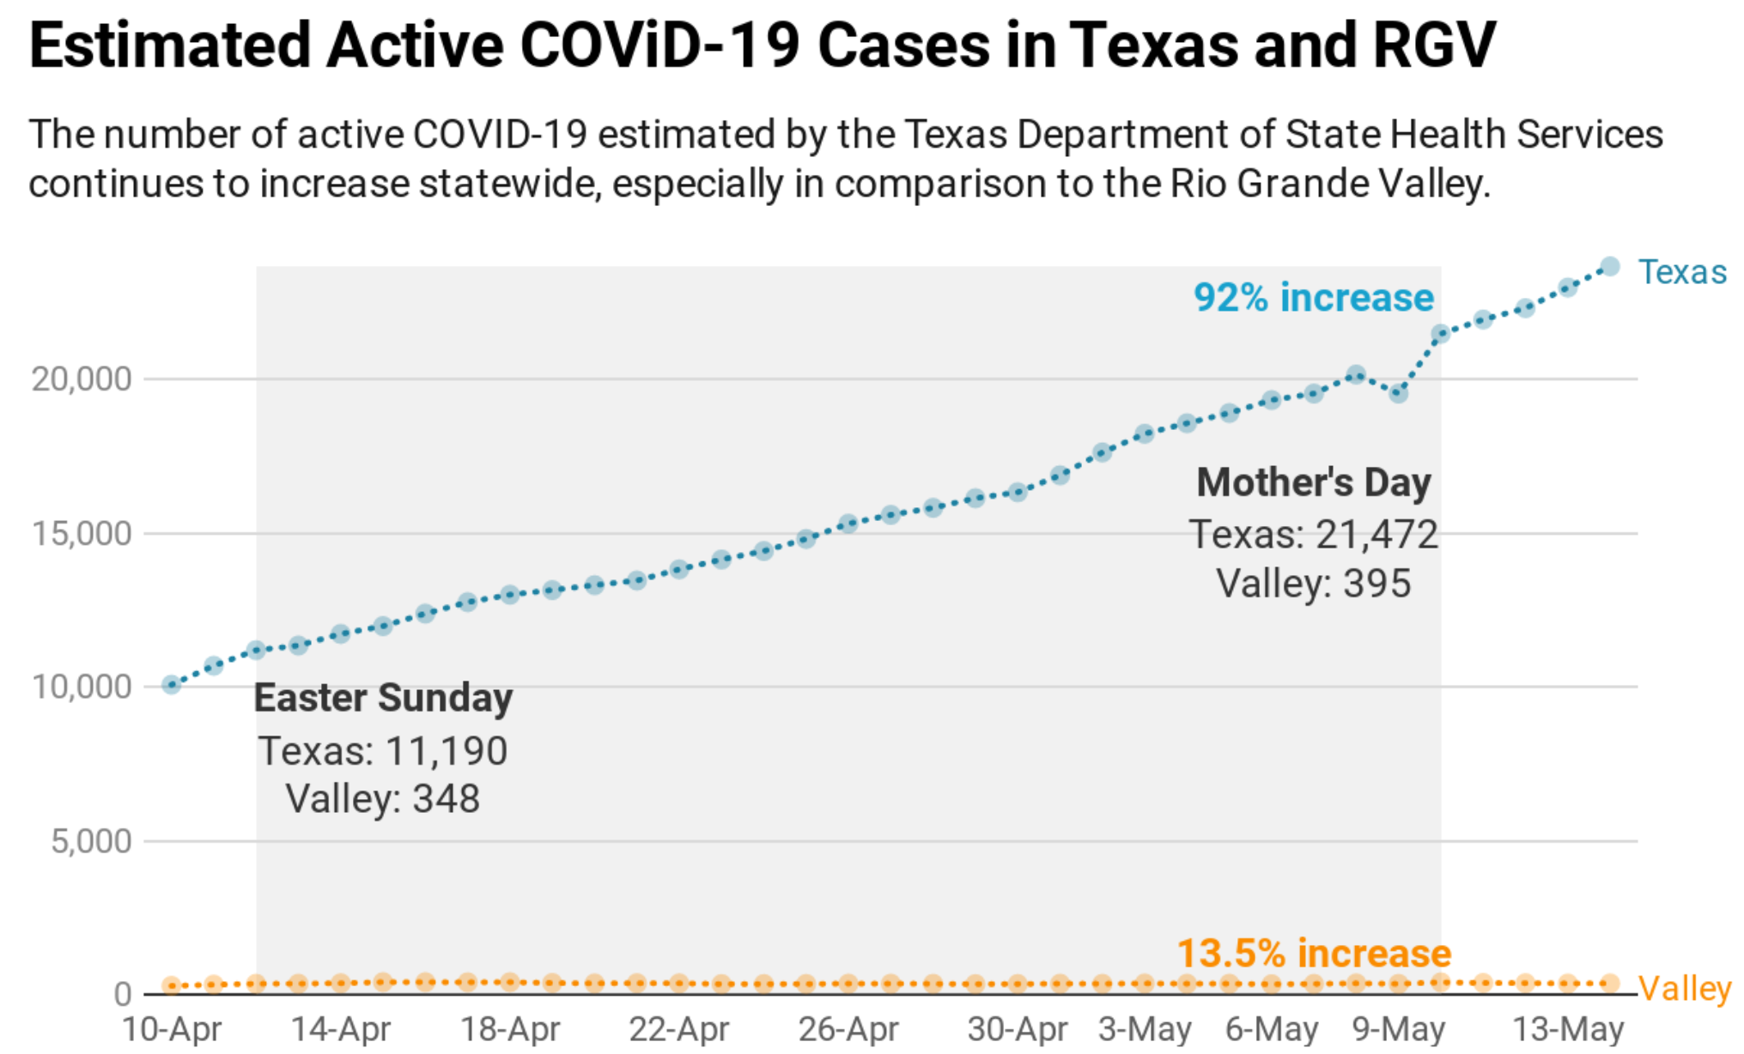
Positive covid-19 cases
Positive cases will be reported to:
Texas Department of Childcare Licensing
Local Health Department
Child test positive
Contact will be made via telephone or letter (hand delivered)
All guidance from CDC and local health department will be followed
Childs contact circle will be to health department
Child in contact with positive individual
Child must quarantine for 14 days

Slide 12
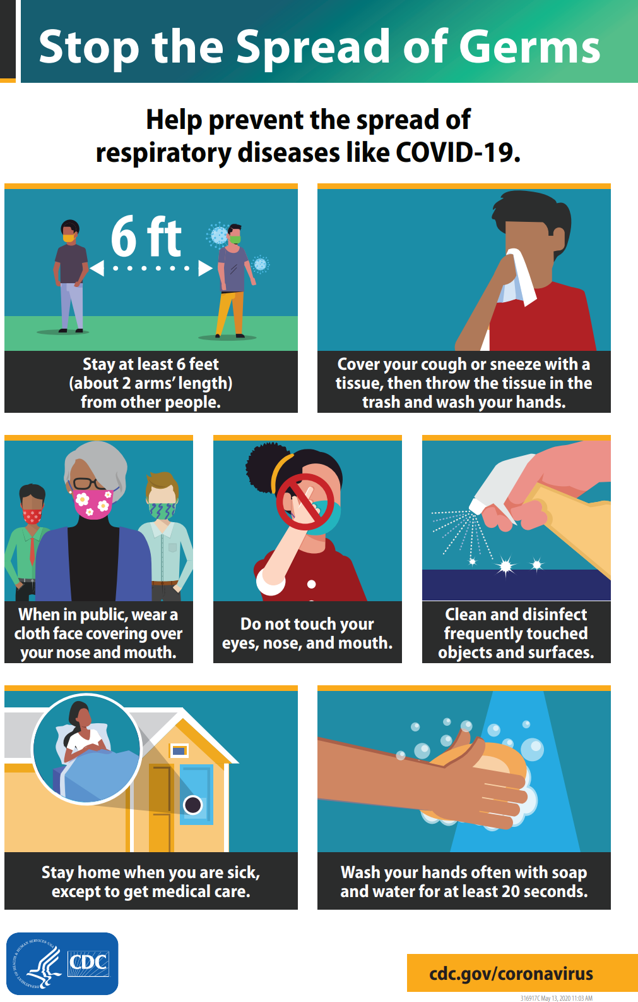
Classrooms strategies to prevent the spread of Covid-19
Eight children per classroom
Plenty of room to spread out and play
Covid-19 Health Check
Floor marks
Encourage mask for children greater than 2 years
Parents, visitors, staff must wear masks
Child will have their own art supplies, playdough, sensory items, etc.

Slide 13
Continue
Children Hand sanitizer, handwashing
Discontinue Family style meals
Food will be pre-plated
Infant feeding
Teachers must wear gloves
Toothbrushing
Parents must do at home
Reminders will be sent on importance of oral hygiene
Increased outside activities
Dress child for outdoor play

Slide 14
Cleaning and Sanitation
Implementation of CDC guidelines
Implementation of State Child Care licensing guidelines
Frequently disinfecting and Sanitizing

Slide 15
Hand Hygiene
Continuation of good hand hygiene to children
Assisting handwashing to children
Alcohol base hand sanitizer of 60%
Use if soap and water not readily available
Sanitizer will not replace handwashing
Kept out of reach of children

Slide 16
Cloth Mask
Staff must always wear
Required for parents during drop off and pick up
Encourage mask for children over 2 years
Removed during rest time
Drinking or eating
Stored/labeled in plastic bag

Slide 17
Parent communication
Communication is KEY
Encourage parents to communicate with comments or concerns
Teamwork can minimize spread of COVID-19

